Slide 1

Database Systems and Big Data
Pertemuan 3
Dr. Dedi Trisnawarman

Slide 2
Database Management System (DBMS):
database: A well-designed, organized, and carefully managed collection of data.
database management system (DBMS): A group of programs used to access and manage a database as well as provide an interface between the database and its users and other application programs.

Slide 3
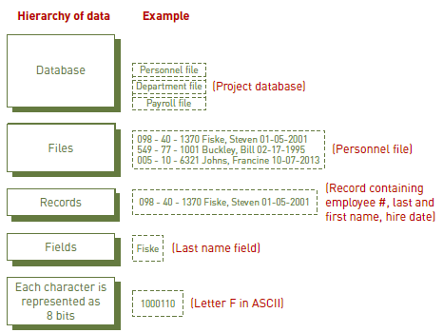
Hierarchy of Data
bit: A binary digit (i.e., 0 or 1) that represents a circuit that is either on or off.
character: A basic building block of most information, consisting of uppercase letters, lowercase letters, numeric digits, or special symbols.
field: Typically a name, a number, or a combination of characters that describes an aspect of a business object or activity.
record: A collection of data fields all related to one object, activity, or individual.
file: A collection of related records.

Slide 4
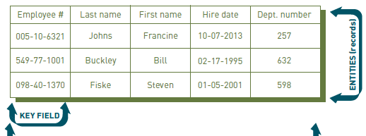
Data Entities, Attributes, and Keys
entity: A person, place, or thing for which data is collected, stored, and maintained.
attribute: A characteristic of an entity.
data item: The specific value of an attribute.
primary key: A field or set of fields that uniquely identifies the record.

Slide 5
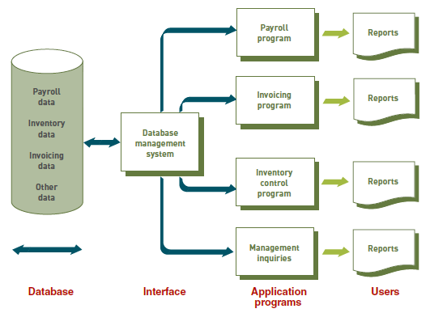
Database Approach
In a database approach to data management, multiple information systems share a pool of related data.

Slide 6
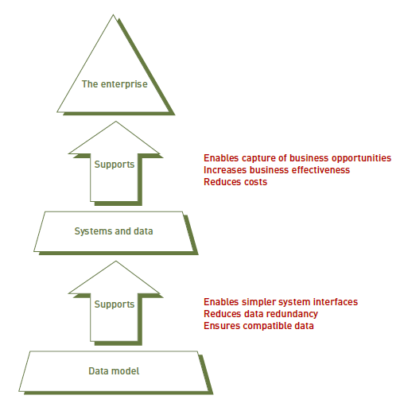
Data Model
data model: A diagram of data entities and their relationships.
enterprise data model: A data model that provides a roadmap for building database and information systems by creating a single definition and format for data that can ensure data compatibility and the ability to exchange and integrate data among systems.

Slide 7
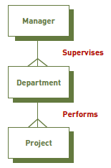
Entity-Relationship (ER) Diagram:
A data model that uses basic graphical symbols to show the organization of and relationships between data.

Slide 8
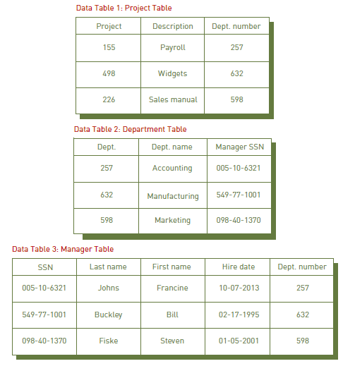
Relational Database Model
Data is placed in two-dimensional tables, or relations. As long as they share at least one common attribute, these relations can be linked to provide output useful information.
In this example, all three tables include the Dept. number attribute.

